Slide 1

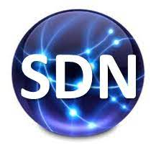




PDS
Computer Vision
Simulasi Jaringan WAN 4 Server DNS, WEB, MAIL, DHCP - Cisco Packet Tracer
Youtube: https://www.youtube.com/@AmelCharoline
Part 1-Simulasi Jaringan WAN 4 Server DNS, WEB, MAIL, DHCP - Cisco Packet Tracer.MP4
Part 2-Simulasi Jaringan WAN 4 Server DNS, WEB, MAIL, DHCP - Cisco Packet Tracer.MP4
@ P. Siagian
https://github.com/siagianp
https://www.youtube.com/@AmelOline/videos
https://github.com/amelcharolinesgn2/IoT_simulator-mqtt-NodeRed
https://www.youtube.com/watch?v=4v7vCZ1p6EI
https://github.com/amelcharolinesgn2/Cloud-Infrastructures
https://github.com/amelcharolinesgn2/ClouD-Infrastructure-SISKA-2025
https://github.com/amelcharolinesgn2/Gyroscope-Sensor-Data-Accelerometer
Notes:
Setting Up Ubuntu 20 Server on VirtualBox for Node.js App
https://github.com/NawalAShaltout/OS-02-/tree/main/Lab-03

Slide 2
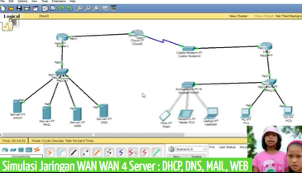
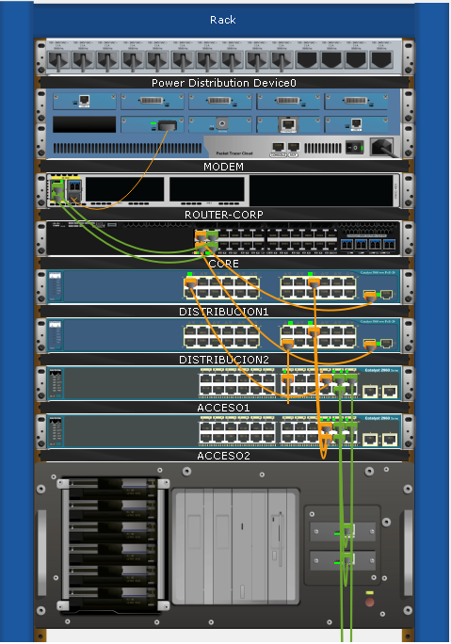
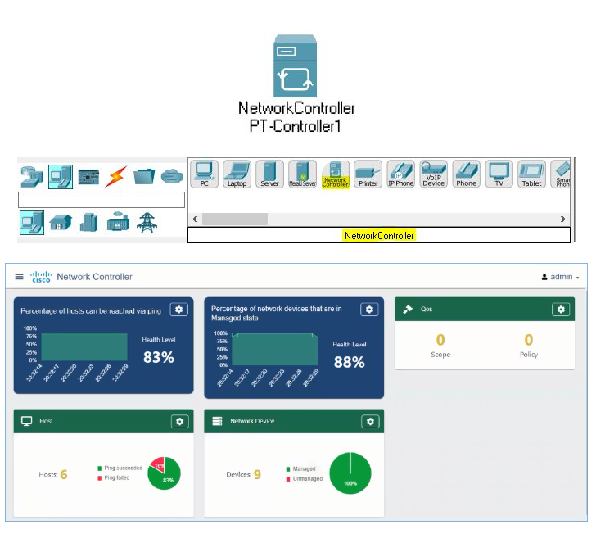
Jaringan WAN 4 Server DNS, WEB, MAIL, DHCP - Cisco Packet Tracer

Slide 3
Youtube: https://www.youtube.com/@AmelCharoline
Part 1-Simulasi Jaringan WAN 4 Server DNS, WEB, MAIL, DHCP - Cisco Packet Tracer.MP4
Part 2-Simulasi Jaringan WAN 4 Server DNS, WEB, MAIL, DHCP - Cisco Packet Tracer.MP4
Simulasi jaringan WAN di Cisco Packet Tracer melibatkan dua router (contoh: PT-Router) yang dihubungkan via kabel serial, menggunakan teknik routing (static/RIP/OSPF). Setiap sisi router terhubung ke Switch dan 4 Server (DNS, Web, Mail, DHCP). DHCP memberikan IP otomatis, DNS memetakan domain ke IP, Web menampilkan HTTP, dan Mail melayani SMTP/POP3.
Membangun simulasi:
1. Topologi Jaringan
Perangkat: 2 Router, 2 Switch, 4 Server, 2-4 PC/Client.
Koneksi:
- Router 1 ke Router 2: Kabel Serial (DCE/DTE) - WAN.
- Router ke Switch: Kabel Straight-Through.
- Switch ke Server/PC: Kabel Straight-Through.
2. Konfigurasi Alamat IP (IP Address)
- Dua segmen jaringan berbeda untuk LAN 1 (misal: 192.168.1.0/24) dan LAN 2 (misal: 192.168.2.0/24).
- Hubungkan kedua router menggunakan segmen IP WAN (misal: 10.10.10.0/30).
- IP Server & Router: Berikan IP Statis.
3. Konfigurasi Routing (PENTING)
LAN 1 dan LAN 2 lakukan saling ping, konfigurasikan routing di kedua router.
Contoh Static Route:
Router 1: ip route 192.168.2.0 255.255.255.0 10.10.10.2
Router 2: ip route 192.168.1.0 255.255.255.0 10.10.10.1
4. Konfigurasi Server
DHCP Server:
Aktifkan Service DHCP.
Isi Default Gateway, DNS Server, dan Start IP Address.
Atur PC klien untuk menerima IP otomatis (DHCP).
DNS Server:
Aktifkan Service DNS.
Tambahkan nama domain (web1: www.smkn1-balige.net; web2: www.sman1-balige.net dan arahkan ke IP Web Server.
Web Server (HTTP):
Aktifkan Service HTTP/HTTPS.
Edit file index.html untuk tampilan web masing-masing web: Selamat dating di www.smkn1-balige.net; web2: www.sman1-balige.net .
Mail Server (SMTP/POP3):
Aktifkan Service Email.
Tambahkan nama domain (contoh: mail.net).
Buat User dan Password untuk client:123.
5. Pengujian (Testing)
Pastikan semua server dapat di-ping dari client.
Buka Web Browser di PC client, akses web1: www.smkn1-balige.net; web2: www.sman1-balige.net.
Konfigurasi Email client di PC, kirim email antarpengguna.

Slide 4
Contoh Static Route:
Router 1: ip route 192.168.2.0 255.255.255.0 10.10.10.2
Router 2: ip route 192.168.1.0 255.255.255.0 10.10.10.1
4. Konfigurasi Server
DHCP Server:
Aktifkan Service DHCP.
Isi Default Gateway, DNS Server, dan Start IP Address.
Atur PC klien untuk menerima IP otomatis (DHCP).
DNS Server:
Aktifkan Service DNS.
Tambahkan nama domain (web1: www.smkn1-balige.net; web2: www.sman1-balige.net dan arahkan ke IP Web Server.
Web Server (HTTP):
Aktifkan Service HTTP/HTTPS.
Edit file index.html untuk tampilan web masing-masing web: Selamat dating di www.smkn1-balige.net; web2: www.sman1-balige.net .
Mail Server (SMTP/POP3):
Aktifkan Service Email.
Tambahkan nama domain (contoh: mail.net).
Buat User dan Password untuk client:123.
5. Pengujian (Testing)
Pastikan semua server dapat di-ping dari client.
Buka Web Browser di PC client, akses web1: www.smkn1-balige.net; web2: www.sman1-balige.net.
Konfigurasi Email client di PC, kirim email antarpengguna.

Slide 5



https://github.com/siagianp
https://www.youtube.com/@AmelOline/videos
https://github.com/amelcharolinesgn2/IoT_simulator-mqtt-NodeRed
https://github.com/amelcharolinesgn2/Cloud-Infrastructures
https://github.com/amelcharolinesgn2/ClouD-Infrastructure-SISKA-2025
https://github.com/amelcharolinesgn2/Gyroscope-Sensor-Data-Accelerometer

